Slide 1
Evaluating Taekwondo Moves
System to recognize and evaluate video of performed taekwondo moves
Srilakshmi Medarametla

Slide 2
Background
Vital to reassure correct and adjust incorrect technique
Current action recognition → Microsoft Kinect
Built off Bagalkot & Wang (‘20) ’s “Creating a Classifier for Dance and Martial Arts Moves” with Facebook’s VideoPose3D instead of Kinect
Notes:
To give you a little background, as a taekwondo athlete, I know it is vital that athletes have an appropriate reassurance of good technique and correction of bad technique for a specific skill or move in order to prevent injury or muscle strain since they typically cannot observe and judge themselves
Current action recognition projects in the field typically use technology such as motion-capture, or Microsoft Kinects sensors which return video input with 3D coordinates of the user’s joints.
However, expanding on the foundational work developed by Neha Bagalkot and Sophia Wang (TJHSST ‘20) in the Computer Systems Lab last year, I plan to create a system to recognize and evaluate taekwondo moves with the more accessible phone camera from a single source.

Slide 3
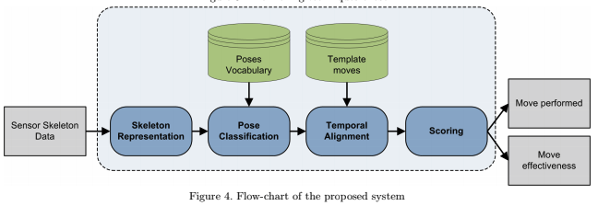
Phases
“Karate Moves Recognition from Skeletal Motion” Bianco & Tisato, 2013
Notes:
This project is largely based off Bianco & Tisato’s 2013 article “Karate Moves Recognition from Skeletal Motion” which outlines the following 3 main modules that a video would go through in order to be classified and evaluated.
The skeleton representation module is needed to transform the raw videos into a meaningful representation of the relative location of a user’s joints.
The pose classification module classifies each skeleton representation into one of previously defined poses.
The temporal alignment module aligns the sequence of vocabulary poses and the template poses in the time domain.
The scoring module computes the similarity between two aligned sequences; it can be used to evaluate the effectiveness of the move itself.

Slide 4
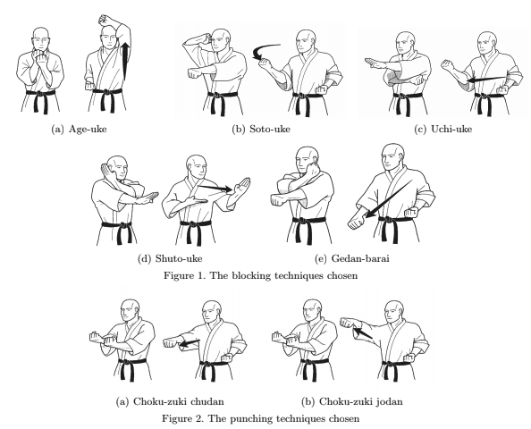
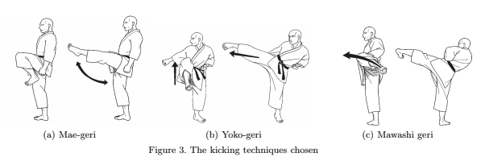
Skeleton Representation: Moves
hb
mboi
mbio
khb
lb
p
hp
fk
sk
rk
Notes:
For a general understanding of what these taekwondo moves look like, I’ve taken a page out of Bianco & Tisato’s article. Although they use karate techniques, these moves are analogous to several taekwondo techniques. I’ve placed the abbreviations underneath
From the upper left down, we can see analogues of high-block

Slide 5

Skeleton Representation: VideoPose3D
Notes:
I’ve asked my taekwondo instructor, pictured in this video, to take about 25 videos for the left-hand and right-hand side of 5 blocks, 2 punches, 3 kicks. In addition to the front-facing view pictured here, he’s also taken diagonal-side facing views, all which compose the about 900 videos that make up my training dataset. All of these videos were taken from common, everyday phones.
Similarly, I took about 3-5 videos for each move to make up about 100 test videos.
It’s important to note here that while usually video from just one view usually can only generate 2D coordinates of the user’s system, so coordinates along just the x,y plane, I’ve managed to get 3D coordinates with Facebook’s VideoPose3D software.

Slide 6
Skeleton Representation: VideoPose3D
Notes:
Once I run this video through the VideoPose3D software I have running on a Google Colab file, I can create the video pictured with the joints superimposed. I’ve written generalized data processing to run this procedure automatically.
It’s important to note here that although 3D extrapolation works reasonably well with middle block out to ins, the extrapolation accuracy is worse with more complicated, quickly-executed motion, like kicking techniques.

Slide 7
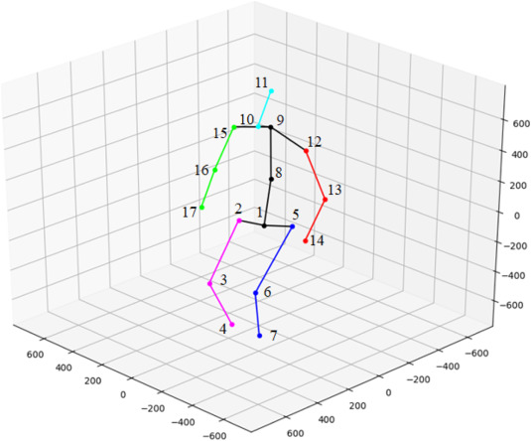
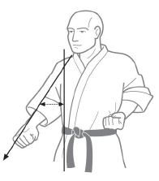
Skeleton Representation: VideoPose3D
Notes:
VideoPose3D uses joints based off the Human 3.6 M Dataset, the 17 joints pictured in the left image
Because, as you can imagine, the distance between joints may vary from user to user (the length of someone’s arm may be shorter or longer, for example), I take the angles between the joints instead, as you can see from the image on the right, the angle between the elbow, shoulder, and chest.

Slide 8
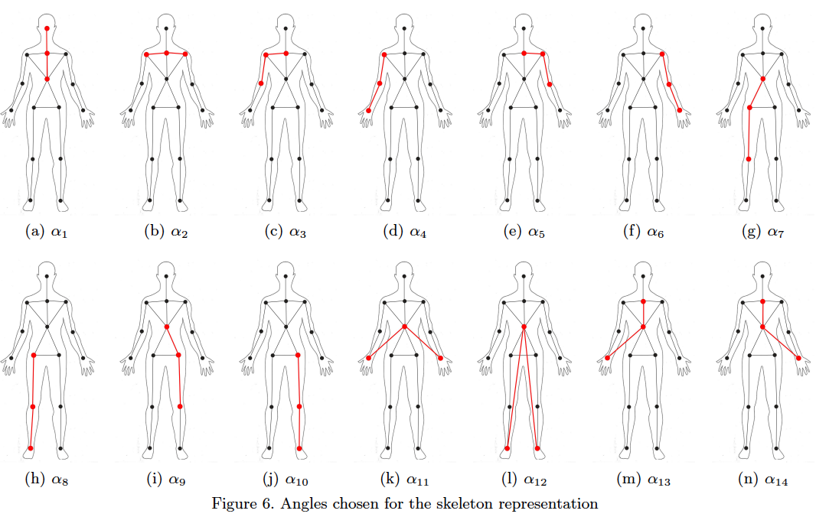
Skeleton Representation: Angles
Notes:
For now, there’s about 14 angles between joints that I’ve chosen to include in my system, for example, the angle at a user’s elbow, but it’s possible to include more in the future to refine the model. These images are based on the joints identified by Microsoft Kinect sensors, so I drew analogues between this and Human 3.6 M’s joints for my system.
So, to recap, once a user inputs video of taekwondo technique, the system goes frame by frame and identifies the athlete’s joints, and consequently the angles. This angles representation of a frame is what I call a pose.

Slide 9
Pose Classification: KNN
Blocking Techniques (Move vs. F1)
hb_l | 0.444
mbio_l | NaN
mboi_l | 0.800
khb_l | 0.455
lb_l | 0.571
hb_r | 0.417
mbio_r | NaN
mboi_r | 0.550
khb_r | 0.182
lb_r | 0.692
Punching Techniques (Move vs. F1)
p_l | NaN
hp_l | 0.424
p_r | 0.363
hp_r | 0.267
Notes:
In order to get a bank of vocabulary poses for each move, I use a clustering algorithm called K-means. After running K-means on the training set videos, I identify 10 key poses for each hand technique and 12 key poses for each kicking techniques.
Using K-nearest-neighbors, which finds the closest vocabulary pose for a given pose based on a vote of where its nearest neighbors belong to, the system again puts to vote where its key poses belong to.
So, to recap, after I have an angles representation of all the frames in a video, say of a certain technique but we don’t know which, I take 10 key poses which represent this video and find which vocabulary pose each most closely matches to. Let’s say 7 out of the 10 match the vocabulary poses for middle-block out-to-ins, then the program will classify this video as a middle block out-to-in.
The F1 score, which is a measure for how well the system performs, is demonstrated in the tables here for the following moves.

Slide 10
Pose Classification: KNN
Kicking Techniques (Move vs. F1)
fk_l | 0.25
rk_l | NaN
sk_l | NaN
fk_r | 0.375
rk_r | 0.286
sk_r | NaN
Notes:
Cluster angles by pose with K-means to make up the bank of vocabulary poses

Slide 11
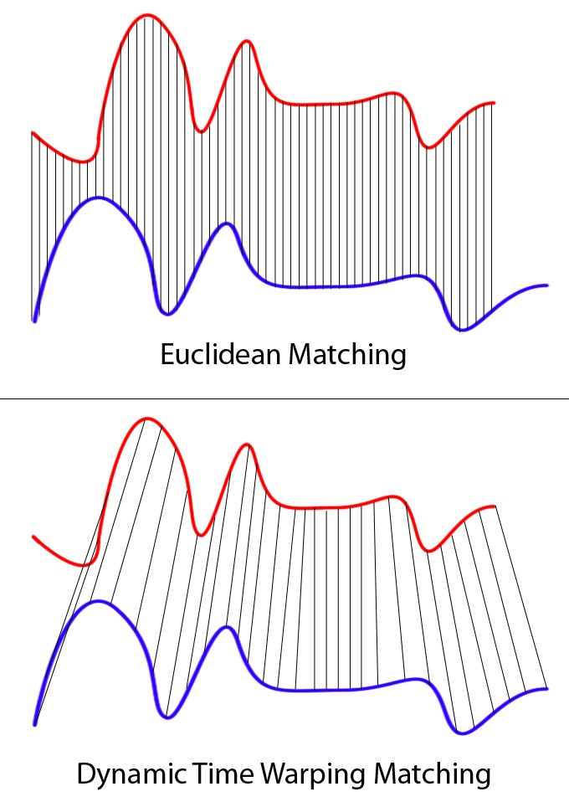
Temporal Alignment & Scoring
Get all ideal videos
Closer to zero, better execution
Notes:
Use DTW to align the series appropriately.
For example, say the blue is a sequence of poses for a given move, say a front kick, of the exemplar/master and the red is the same for a user. The user may perform the more quickly than the exemplar, but that doesn’t mean that their technique is incorrect which it would if we scored the sequence with Euclidean matching. With DTW, we match the highs with the highs and the lows with the lows to more accurately evaluate how closely the user’s performance matches the master’s. This similarity score is the basis for the scoring, which is the end of the system.

Slide 12
Discussion
Slower video
Different angles
Try other skeleton recognition modules (CMU’s OpenPose)
Optimize classification algorithms
Notes:
Use slower video. One aspect where I noticed VideoPose3D had difficulty was if the athlete executed the move too quickly and for a moment, for a couple of frames, the image was blurred, then the algorithm can no longer detect the joints in the user’s system. If it can’t detect the joints, it can’t identify the angles between the joints, and the system’s accuracy drops dramatically from there
Different angles
Use another skelton recognition module. This module was actually a contender for this system initially, but due time constraints and the intensiveness of calibration needed to generate 3D coordinates, I opted for VideoPose3D
Optimize classification algorithms, B&T’s uses SVMs instead of KNN

